Slide 1
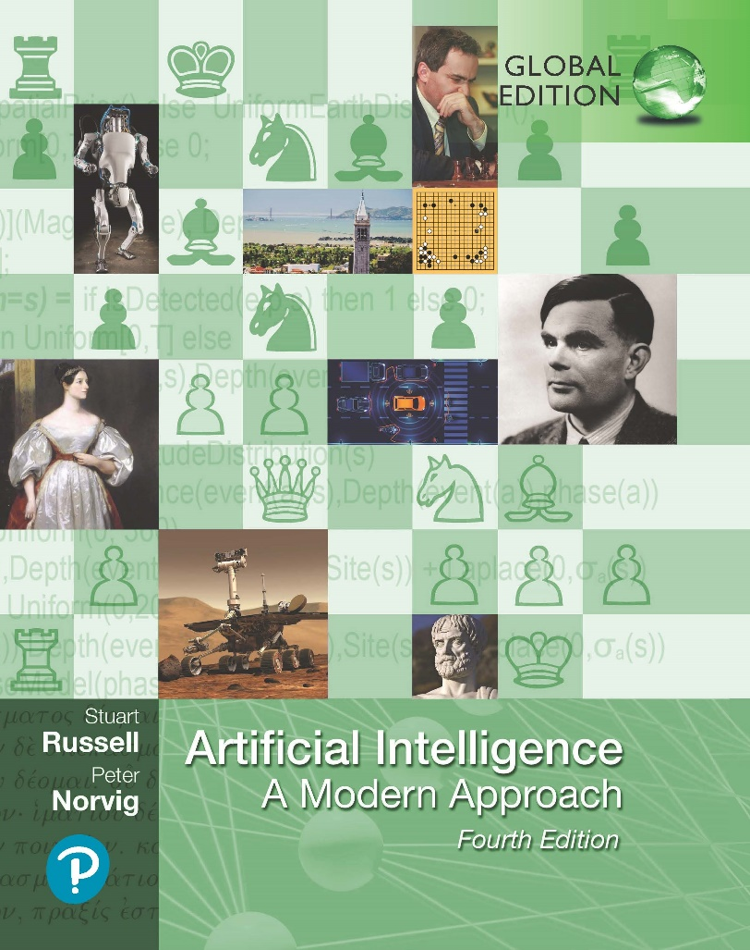
Artificial Intelligence: A Modern Approach
Fourth Edition, Global Edition
Chapter 26
Robotics
© 2022 Pearson Education Ltd.

Slide 2
Outline
Robots
Robot Hardware
What kind of problem is robotics solving?
Robotic Perception
Planning and Control
Planning Uncertain Movements
Reinforcement Learning in Robotics
Humans and Robots
Application Domains

Slide 3
Robots
physical agents that perform tasks by manipulating the physical world
equipped with effectors such as legs, wheels, joints, and grippers
equipped with sensors, which enable them to perceive their environment
Maximizing expected utility for a robot means choosing how to actuate its effectors to assert the right physical forces
partially observable and stochastic
usually model their environment with a continuous state space
Robotic learning is constrained because the real world operates at real time

Slide 4
Robot Hardware
Types of robots from the hardware perspective
Manipulators: just robot arms
Large payload (assembling cars)
Wheelchair mountable arms
Mobile robots are those that use wheels, legs, or rotors to move about the environment
Quadcopter drones are a type of unmanned aerial vehicle (UAV)
Other kinds of robots include prostheses, exoskeletons, robots with wings, swarms, and intelligent environments in which the robot is the entire room.

Slide 5
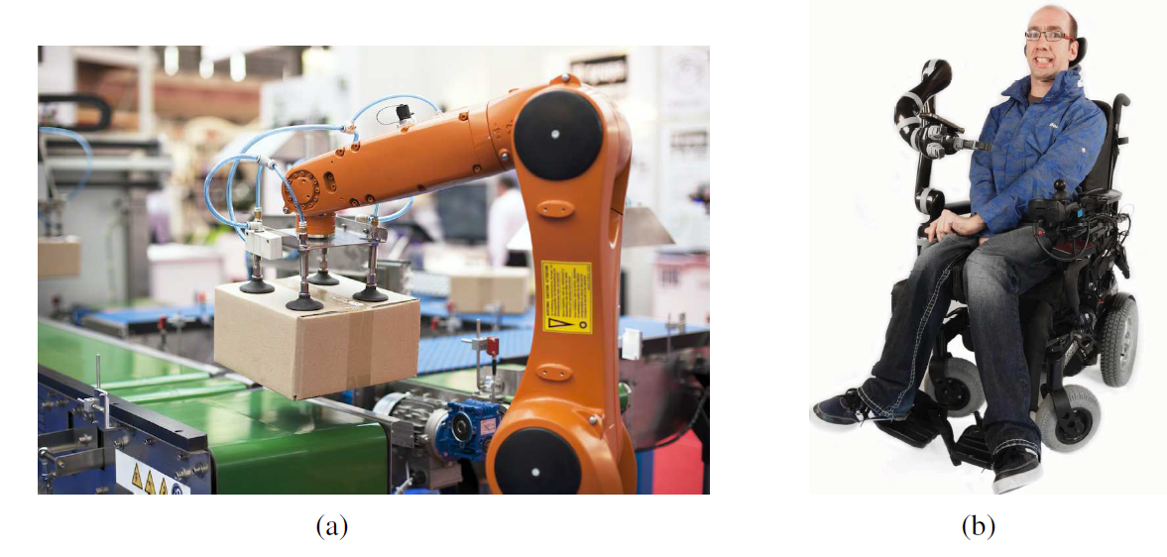
Robot Hardware
An industrial robotic arm with a custom end-effector. Image credit: Macor/123RF.
Kinova® JACO® Assistive Robot arm mounted on a wheelchair. Kinova and JACO are trademarks of Kinova, Inc.

Slide 6
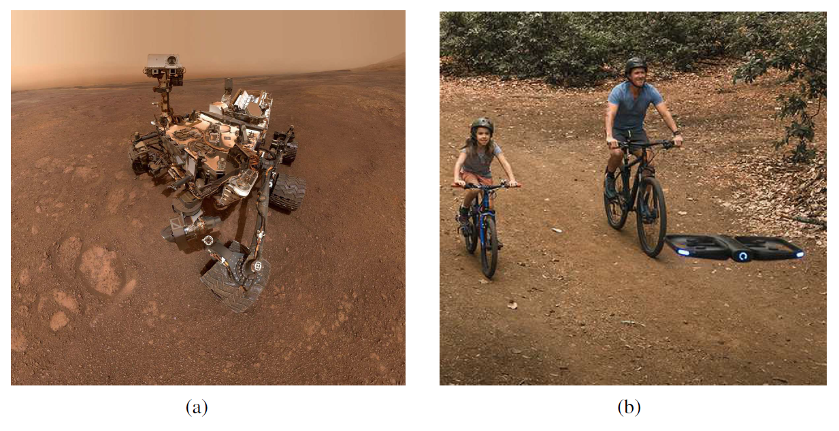
Robot Hardware
(a) NASA’s Curiosity rover taking a selfie on Mars. Image courtesy of NASA.
(b) A Skydio drone accompanying a family on a bike ride. Image courtesy of Skydio.

Slide 7
Robot Hardware
Sensing the world
Passive sensors, such as cameras, are true observers of the environment: they capture signals that are generated by other sources in the environment
Active sensors, such as sonar, send energy into the environment
Range finders are sensors that measure the distance to nearby object
Stereo vision relies on multiple cameras to image the environment from slightly different viewpoints, analyzing the resulting parallax in these images to compute the range of surrounding objects
Autonomous cars often use scanning lidars (short for light detection and ranging): active sensors that emit laser beams and sense reflected beam
Radar is often the range finding sensor of choice for air vehicles

Slide 8
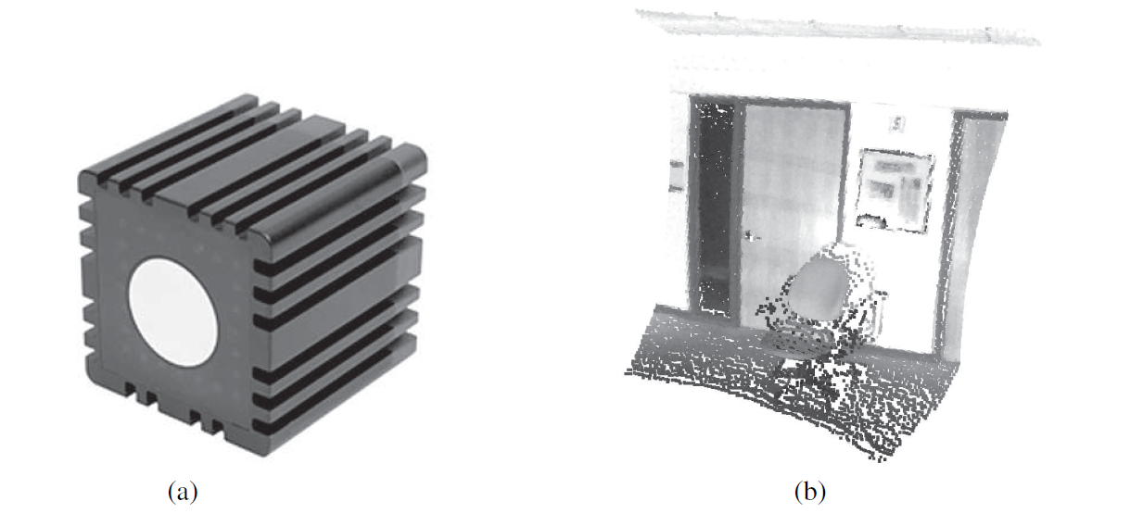
Robot Hardware
Time-of-flight camera; image courtesy of Mesa Imaging GmbH.
3D range image obtained with this camera. The range image makes it possible to detect obstacles and objects in a robot’s vicinity. Image courtesy of Willow Garage, LLC.

Slide 9
Robot Hardware
Producing motion
Actuator: The mechanism that initiates the motion of an effector
Electric actuator uses electricity to spin up a motor
Hydraulic actuators use pressurized hydraulic fluid (like oil or water)
Pneumatic actuators use compressed air
Actuators are often used to move joints, which connect rigid bodies (links)
In revolute joints, one link rotates with respect to the other. In prismatic joints, one link slides along the other.

Slide 10
What kind of problem is robotics solving?
Robotics use a three-level hierarchy:
The task planning level decides a plan or policy for high-level actions
Then motion planning is in charge of finding a path that gets the robot from one point to another, achieving each subgoal
Control is used to achieve the planned motion using the robot’s actuators
Preference learning is in charge of estimating an end user’s objective, and
people prediction is used to forecast the actions of other people in the robot’s environment

Slide 11
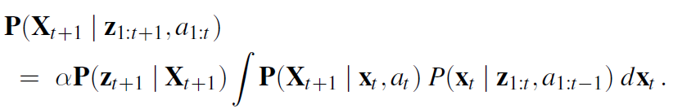
Robotic Perception
Perception is the process by which robots map sensor measurements into internal representations of the environment
good internal representations for robots have three properties:
1. They contain enough information for the robot to make good decisions.
2. They are structured so that they can be updated efficiently.
3. They are natural in the sense that internal variables correspond to natural state variables in the physical world.
The posterior P(X_{t} z_{1:t}, a_{1:t−1}) is the sensor model, a probability distribution over all states that captures what we know from past sensor measurements and controls.
P(X_{t+1} | x_{t}, a_{t}) is called the transition model or motion model,

Slide 12
Robotic Perception
Localization and mapping
Localization is the problem of finding out where things are—including the robot itself. Localization using particle filtering is called Monte Carlo localization, or MCL
MCL algorithm is an instance of the particle-filtering algorithm
The Kalman filter is the other major way to localize. A Kalman filter represents the posterior P(X_{t} | z_{1:t}, a_{1:t−1}) by a Gaussian. A Kalman filter that linearizes via Taylor expansion is called an extended Kalman filter (or EKF).
The problem of needing to know the identity of landmarks is an instance of the data association problem
In some situations, no map of the environment is available, this problem has been studied extensively under the name simultaneous localization and mapping, abbreviated as SLAM.
SLAM problems are solved using many different probabilistic techniques, including the extended Kalman filter

Slide 13
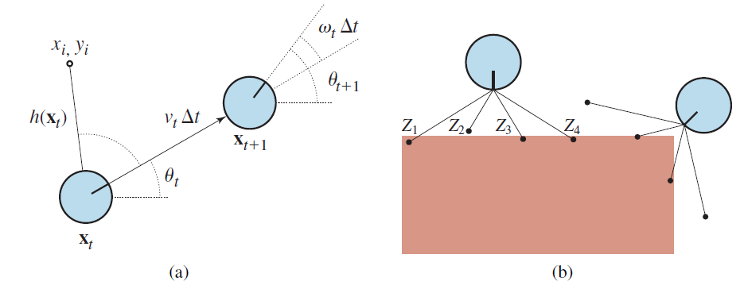
Robotic Perception
A simplified kinematic model of a mobile robot. The robot is shown as a circle with an interior radius line marking the forward direction. The state x_{t} consists of the (x_{t}, y_{t}) position (shown implicitly) and the orientation θ_{t}. The new state x_{t+1} is obtained by an update in position of v_{t}∆_{t} and in orientation of ω_{t}∆_{t}. Also shown is a landmark at (x_{i}, y_{i}) observed at time t.
The range-scan sensor model. Two possible robot poses are shown for a given range scan (z₁, z₂, z₃, z₄). It is much more likely that the pose on the left generated the range scan than the pose on the right.

Slide 14
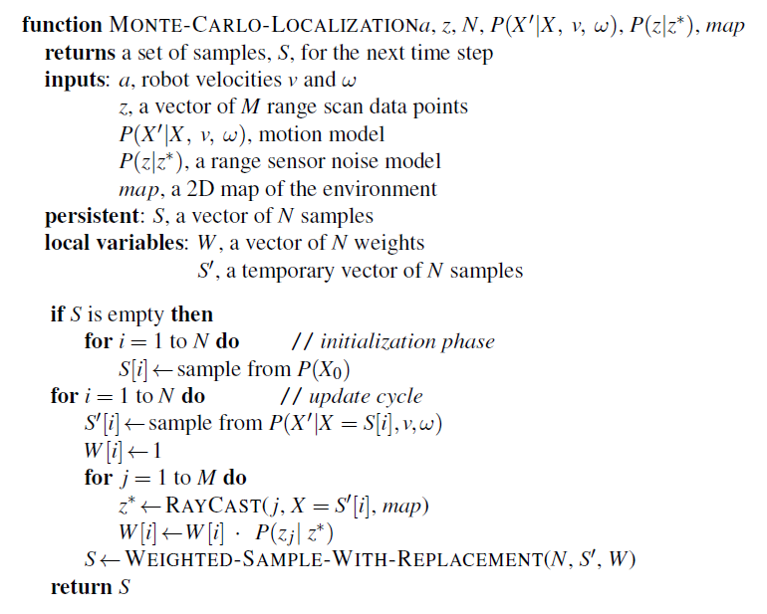
Robotic Perception
A Monte Carlo localization algorithm using a range-scan sensor model with independent noise.

Slide 15
Robotic Perception
Other types of perception
Robots also perceive temperature, odors, sound, and so on
Can be estimated using variants of dynamic Bayes networks
Required for such estimators are conditional probability distributions that characterize the evolution of state variables over time, and sensor models that describe the relation of measurements to state variables.
Trend in robotics is growing towards representations with well-defined semantics
Probabilistic techniques, statistical techniques and simpler solutions
To help decide which approach to take, experience working with real physical robots is your best teacher..

Slide 16
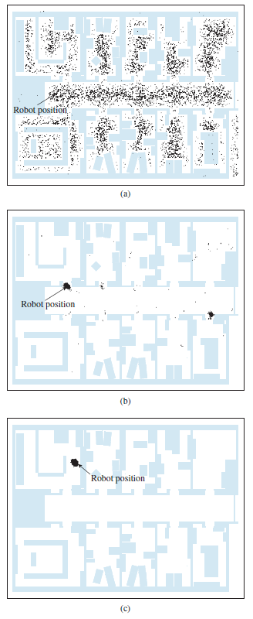
Robotic Perception
Monte Carlo localization, a particle filtering algorithm for mobile robot localization.
Initial, global uncertainty.
Approximately bimodal uncertainty after navigating in the (symmetric) corridor.
Unimodal uncertainty after entering a room and finding it to be distinctive

Slide 17
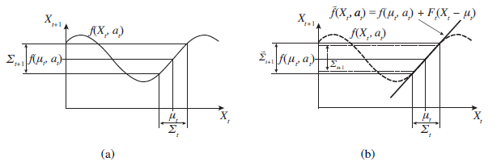
Robotic Perception
One-dimensional illustration of a linearized motion model:
The function f , and the projection of a mean µt and a covariance interval (based on Σt) into time t + 1.
The linearized version is the tangent of f at µ_{t} . The projection of the mean µt is correct. However, the projected covariance Σ˜t+1 differs from Σ_{t+1}.

Slide 18
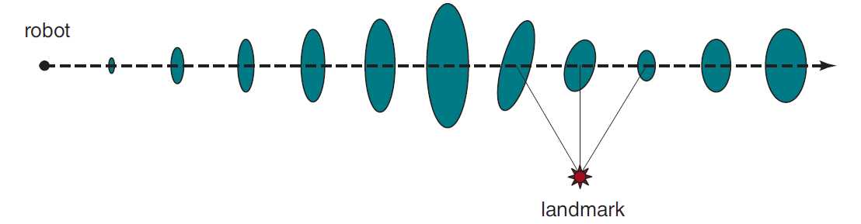
Robotic Perception
Localization using the extended Kalman filter. The robot moves on a straight
line. As it progresses, its uncertainty in its location estimate increases, as illustrated by the error ellipses. When it observes a landmark with known position, the uncertainty is reduced

Slide 19
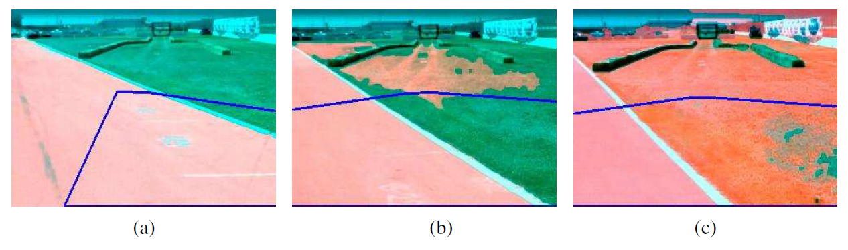
Robotic Perception
Sequence of “drivable surface” classifications using adaptive vision.
Only the road is classified as drivable (pink area). The V-shaped blue line shows where the vehicle is heading.
The vehicle is commanded to drive off the road, and the classifier is beginning to classify some of the grass as drivable.
The vehicle has updated its model of drivable surfaces to correspond to grass as well as road. Courtesy of Sebastian Thrun

Slide 20
Planning and Control
Path as a sequence of points in geometric space that a robot (or a robot part, such as an arm) will follow
The task of finding a good path is called motion planning
Once we have a path, the task of executing a sequence of actions to follow the path is called trajectory tracking control
Trajectory is a path that has a time associated with each point on the path
Configuration space
The physical space that a robot moves about in is called the workspace
Configuration space, or C-space: representation scheme in which all the points
that comprise the robot are represented as a single point in an abstract multidimensional space

Slide 21
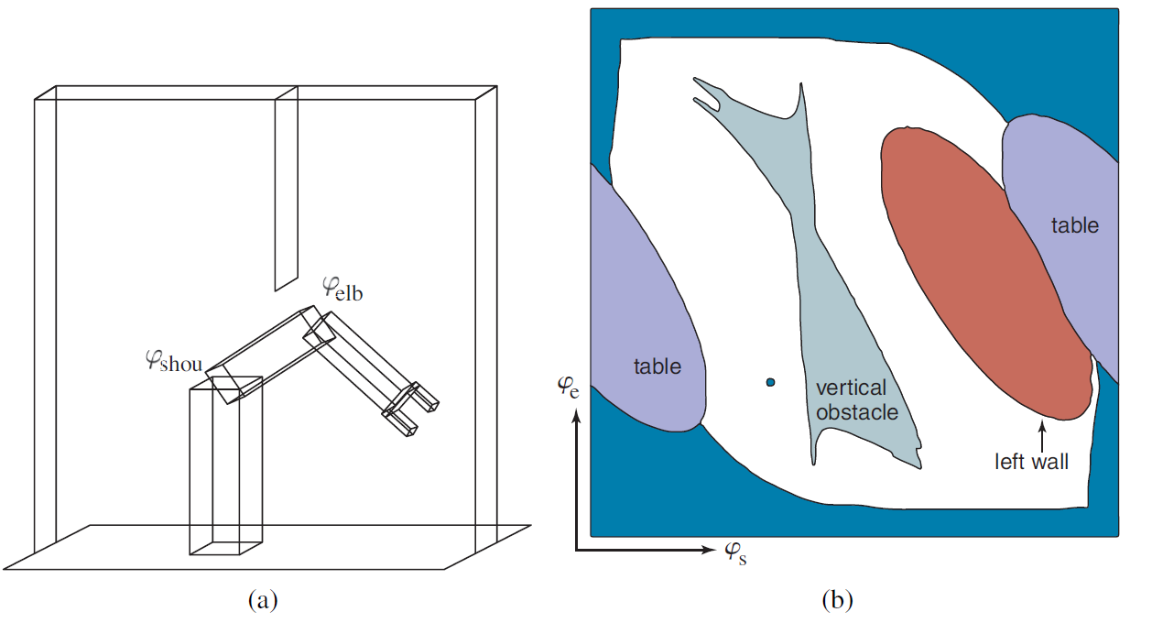
Planning and Control
Workspace representation of a robot arm with two degrees of freedom. The workspace is a box with a flat obstacle hanging from the ceiling.
Configuration space of the same robot. Only white regions in the space are configurations that are free of collisions. The dot in this diagram corresponds to the configuration of the robot shown on the left.

Slide 22
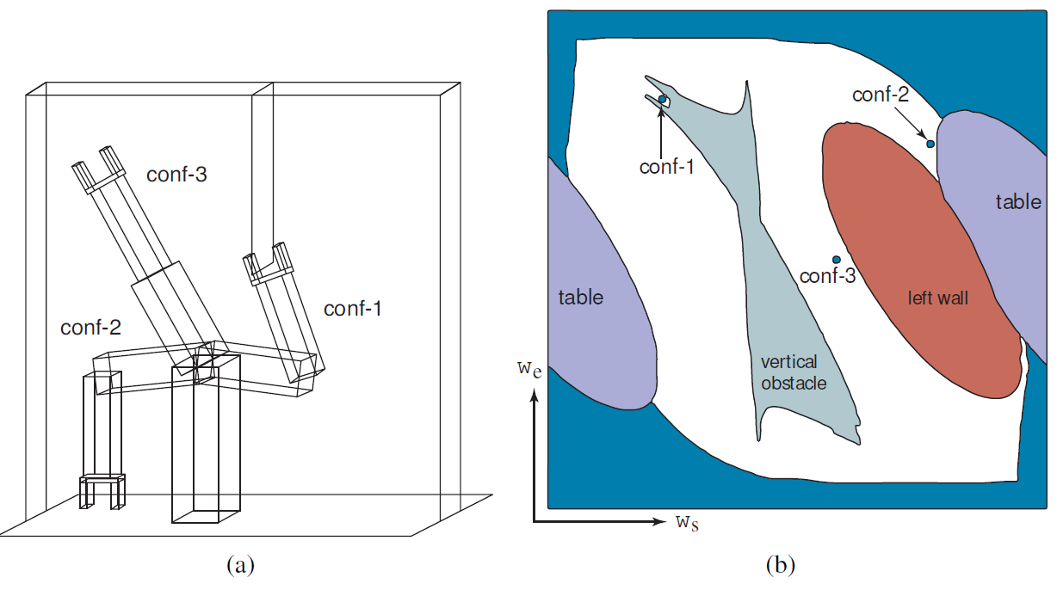
Planning and Control
Three robot configurations, shown in workspace and configuration space.

Slide 23
Planning and Control
Motion planning
quintessentially continuous-state search problem & sometimes referred to as the piano mover’s problem
Once we have a path, the task of executing a sequence of actions to follow the as a single point in an abstract multidimensional space
a workspace world W in either R² for the plane or R³ for three dimensions,
an obstacle region O ⊂ W ,
a robot with a configuration space C and set of points A(q) for q ∈ C,
a starting configuration q_{s} ∈ C, and
a goal configuration q_{g} ∈ C.
some ways of solving the motion planning problem
Visibility graphs
Voronoi diagrams
Cell decomposition
Randomized motion planning
Rapidly-exploring random trees (RRT)
Trajectory optimization for kinematic planning

Slide 24
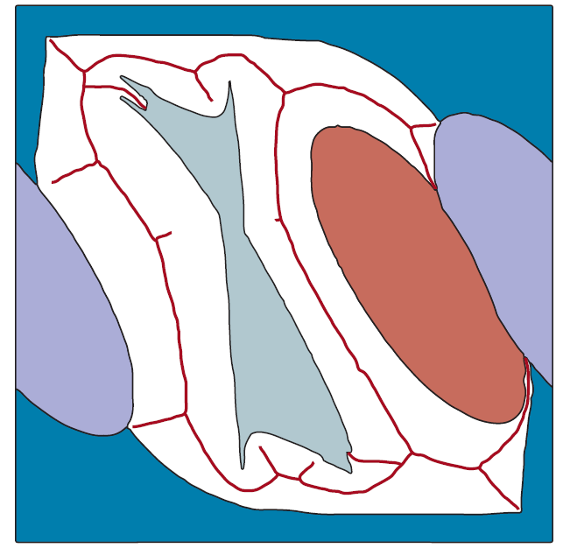
Planning and Control
A Voronoi diagram showing the set of points (black lines) equidistant to two
or more obstacles in configuration space

Slide 25
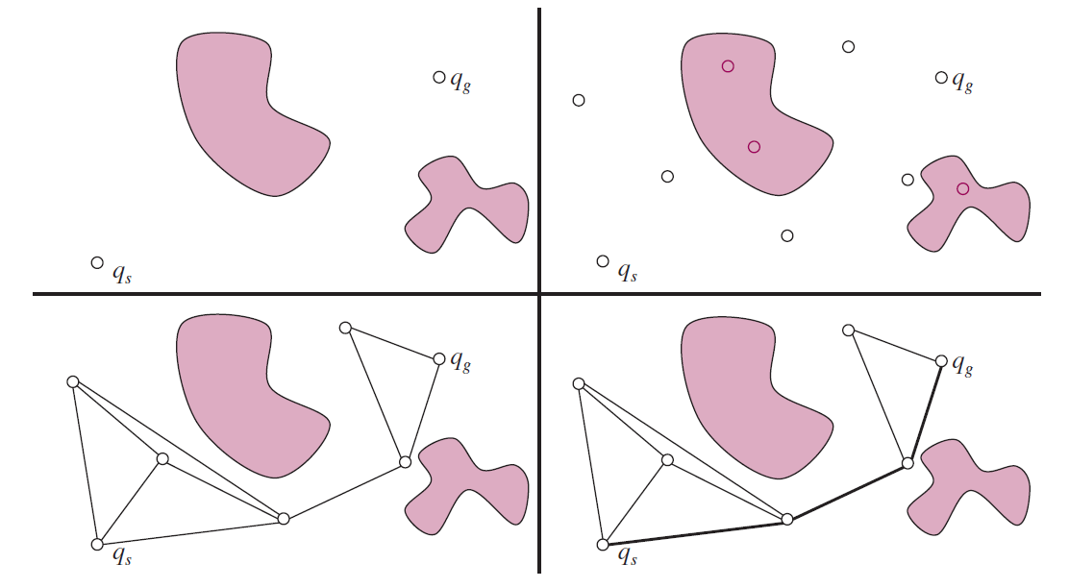
Planning and Control
The bidirectional RRT algorithm constructs two trees (one from the start, the
other from the goal) by incrementally connecting each sample to the closest node in each tree, if the connection is possible. When a sample connects to both trees, that means we have found a solution path.

Slide 26
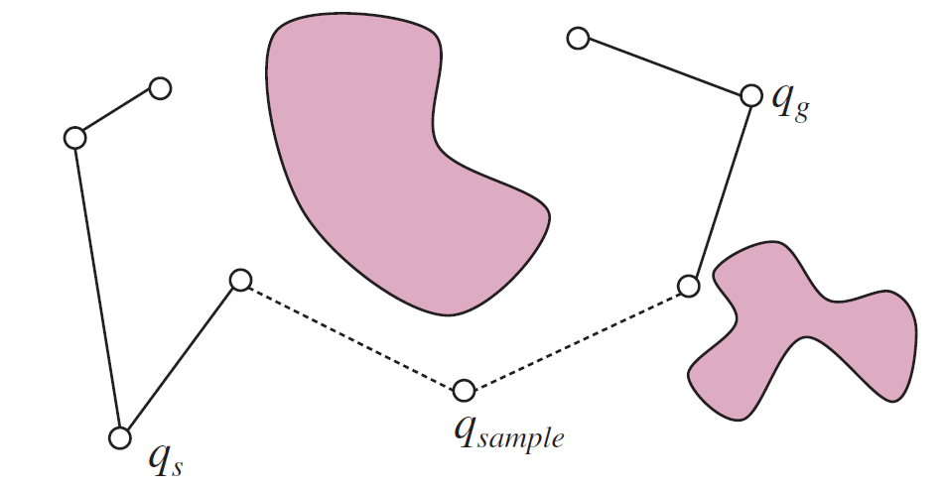
Planning and Control
The probabilistic roadmap (PRM) algorithm. Top left: the start and goal con- figurations. Top right: sample M collision-free milestones (here M = 5). Bottom left: con- nect each milestone to its k nearest neighbors (here k = 3). Bottom right: find the shortest art to the goal on the resulting graph.

Slide 27

Planning and Control
Trajectory optimization for motion planning. Two point-obstacles with circular
bands of decreasing cost around them. The optimizer starts with the straight line trajectory, and lets the obstacles bend the line away from collisions, finding the minimum path through the cost field.

Slide 28
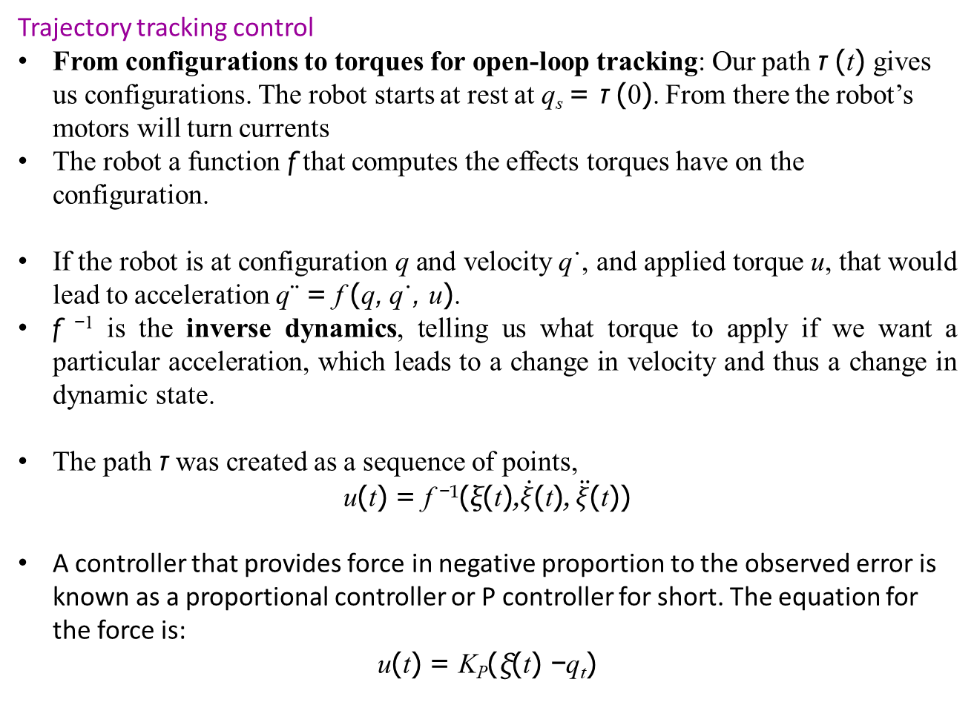
Planning and Control
Trajectory tracking control
From configurations to torques for open-loop tracking: Our path τ (t) gives us configurations. The robot starts at rest at q_{s} = τ (0). From there the robot’s motors will turn currents
The robot a function f that computes the effects torques have on the configuration.
If the robot is at configuration q and velocity q˙, and applied torque u, that would lead to acceleration q¨ = f (q, q˙, u).
f ⁻¹ is the inverse dynamics, telling us what torque to apply if we want a particular acceleration, which leads to a change in velocity and thus a change in dynamic state.
The path τ was created as a sequence of points,
u(t) = f ⁻¹(ξ(t),$\dot{ξ}$(t), $\ddot{ξ}$(t))
A controller that provides force in negative proportion to the observed error is known as a proportional controller or P controller for short. The equation for the force is:
u(t) = K_{P}(ξ(t) −q_{t})

Slide 29
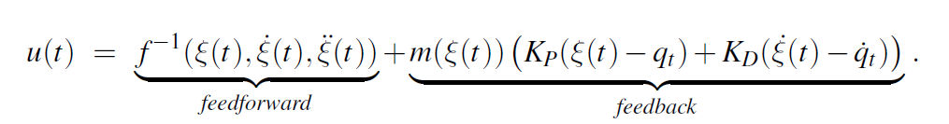
Planning and Control
Trajectory tracking control
A controller is said to be stable if small perturbations lead to a bounded error between the robot and the reference signal
strictly stable if it is able to return to and then stay on its reference path upon such perturbation
PD controller: The letter ‘P’ stands again for proportional, and ‘D’ stands for derivative
u(t) = K_{P}(ξ(t) −q_{t}) + K_{D}(ξ^{˙(t) − q˙}_{t}) .
PID controller (for proportional integral derivative)
computed torque control:

Slide 30
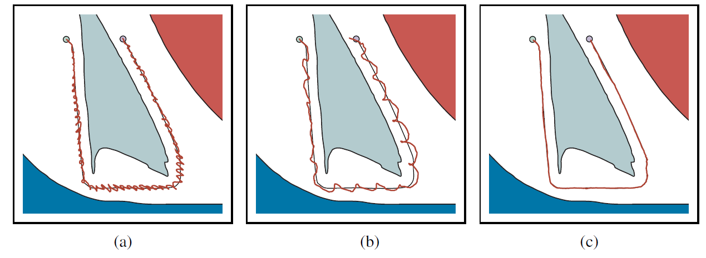
Planning and Control
Robot arm control using (a) proportional control with gain factor 1.0, (b) proportional control with gain factor 0.1, and (c) PD (proportional derivative) control with gain factors 0.3 for the proportional component and 0.8 for the differential component. In all cases the robot arm tries to follow the smooth line path, but in (a) and (b) deviates substantially from the path.

Slide 31
Planning Uncertain Movements
Robots deal with the continuous state space by turning it into a discrete space
Robots deal with uncertainty in the current state by choosing the most likely state from the probability distribution produced by the state estimation algorithm
instead of deterministic plans, uncertainty calls for policies
online replanning
model predictive control (MPC): plan for a shorter time horizon, but replan at every time step
uncertainty calls for information gathering actions
better captured by the POMDP framework
Guarded movements: explicitly defined information gathering actions
Each guarded motion consists of (1) a motion command and (2) a termination condition, which is a predicate on the robot’s sensor values saying when to stop

Slide 32
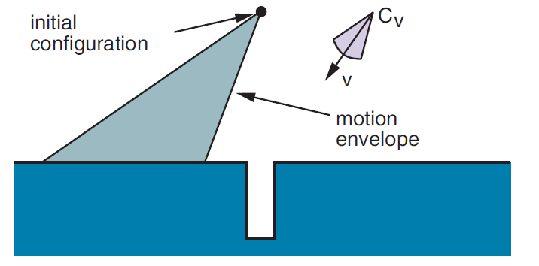
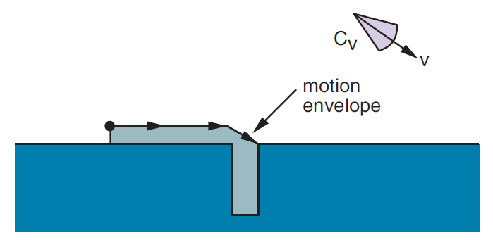
Planning Uncertain Movements
techniques beyond guarded movements
change the cost function to incentivize actions we know will lead to information
coastal navigation heuristic: requires the robot to stay near known landmarks
incorporate the expected information gain (reduction of entropy of the belief) as a term in the cost function
The first motion command and the resulting envelope of possible robot motions.
The second motion command and the envelope of possible motions. Even with error, we will eventually get into the hole.

Slide 33
Reinforcement Learning in Robotics
One challenge of RL in robotics is the continuous nature of the state and action spaces
boils down to how we might reduce the real world sample complexity
the number of interactions with the physical world that the robot needs before it has learned how to do the task.
model-based reinforcement learning
sim-to-real transfer: transferring policies that work in simulation to real world
Use model as a simulator for policy search
End-to-end learning:
More recent techniques have experimented with fitting local models, planning with them to generate actions, and using these actions as supervision to fit a policy, then iterating to get better and better models around the areas that the policy needs.
Exploiting other information
use higher-level motion primitive
metalearning or transfer learning

Slide 34
Humans and Robots
Coordination problem: optimizing reward when there are people acting in the same environment as the robot.
When the human and the robot are on the same team, this turns into collaboration
optimizing for what people actually want.
Coordination
formulate coordination with a human is to model it as a game between the robot and the human
state of the environment (robot & human), x = (x_{R}, x_{H});
each agent can take actions, u_{R} and u_{H} respectively;
each agent has an objective that can be represented as a cost, J_{R} and J_{H}:
each objective depends on the state and on the actions of both agents: J_{R}(x, u_{R}, u_{H}) and J_{H}(x, u_{H}, u_{R}).
Three important aspects complicate this game:
Incomplete information game don’t know each other’s objective
state and action spaces are continuous
human’s behavior might not always be well-characterized as a solution to the game

Slide 35
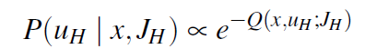
Humans and Robots
Predicting human action
The robot can create a model for P(u_{H} | x, J_{H}), for instance using the softmax
Q(x, u_{H}; J_{H}) the Q-value function corresponding to J_{H} (the negative sign is there because in robotics we like to minimize cost, not maximize reward).
Human predictions about the robot
the robot does not know the human’s objective and the human, in turn, does not know the robot’s objective
Collaboration: A special case of the game when human and the robot are on the same team, same goal or objective: J_{H} = J_{R}.
a joint agent whose actions are tuples of human–robot actions, (u_{H}, u_{R}) and who optimizes for J_{H}(x, u_{H}, u_{R}) = J_{R}(x, u_{R}, u_{H})
compute the optimal plan or policy for the joint agent
Human don’t follow perfectly laid plan
model predictive control (MPC) is the answer

Slide 36
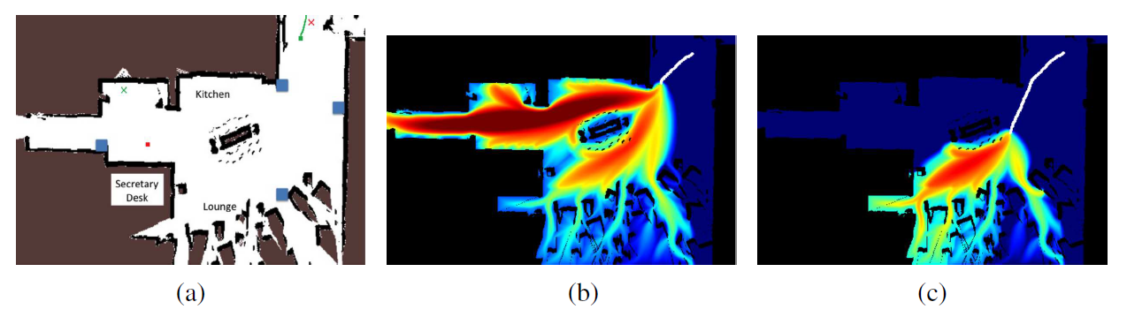
Humans and Robots
Making predictions by assuming that people are noisily rational given their goal: the robot uses the past actions to update a belief over what goal the person is heading to, and then uses the belief to make predictions about future actions.
The map of a room.
Predictions after seeing a small part of the person’s trajectory (white path);
Predictions after seeing more human actions: the robot now knows that the person is not heading to the hallway on the left, because the path taken so far would be a poor path if that were the person’s goal.
Images courtesy of Brian D. Ziebart. See Ziebart et al. (2009).

Slide 37
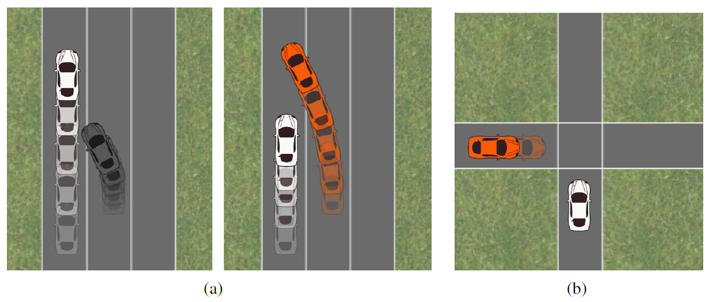
Humans and Robots
Left: An autonomous car (middle lane) predicts that the human driver (left lane) wants to keep going forward, and plans a trajectory that slows down and merges behind. Right: The car accounts for the influence its actions can have on human actions, and realizes it can merge in front and rely on the human driver to slow down.
That same algorithm produces an unusual strategy at an intersection: the car realizes that it can make it more likely for the person (bottom) to proceed faster through the intersection by starting to inch backwards. Images courtesy of Anca Dragan.

Slide 38
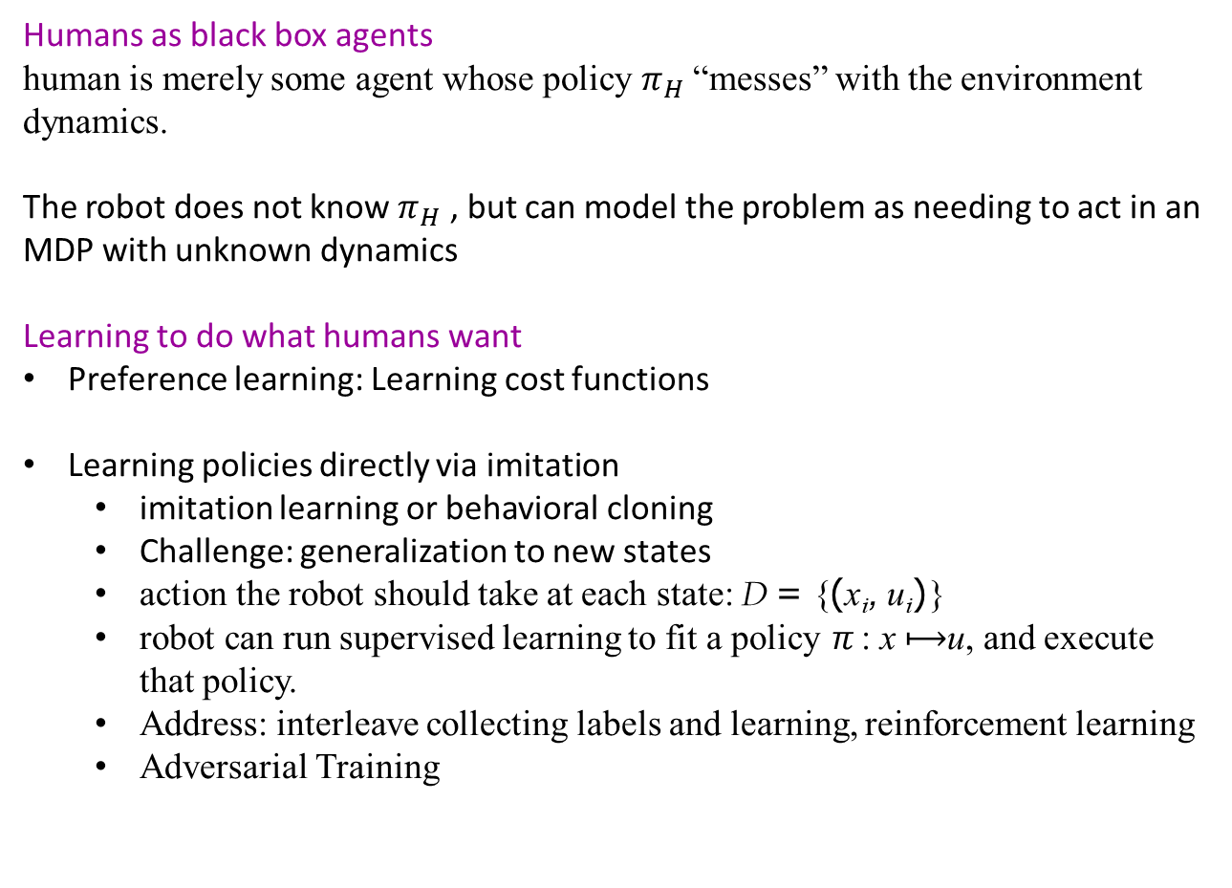
Humans and Robots
Humans as black box agents
human is merely some agent whose policy $π_{H}$ “messes” with the environment dynamics.
The robot does not know $π_{H}$ , but can model the problem as needing to act in an MDP with unknown dynamics
Learning to do what humans want
Preference learning: Learning cost functions
Learning policies directly via imitation
imitation learning or behavioral cloning
Challenge: generalization to new states
action the robot should take at each state: D = {(x_{i}, u_{i})}
robot can run supervised learning to fit a policy π : x $⟼$u, and execute that policy.
Address: interleave collecting labels and learning, reinforcement learning
Adversarial Training

Slide 39
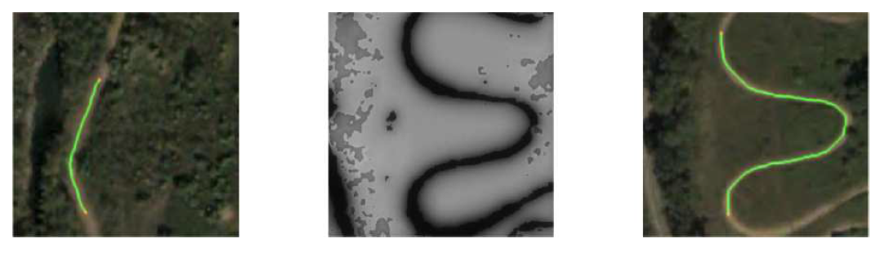
Humans and Robots
Left: A mobile robot is shown a demonstration that stays on the dirt road.
Middle: The robot infers the desired cost function, and uses it in a new scene, knowing to put lower cost on the road there.
Right: The robot plans a path for the new scene that also stays on the road, reproducing the preferences behind the demonstration.

Slide 40
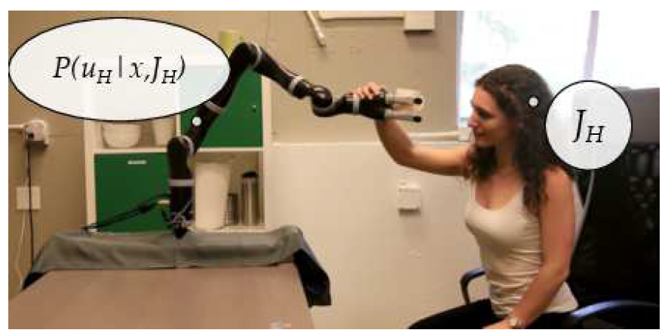
Humans and Robots
A human teacher pushes the robot down to teach it to stay closer to the table. The robot appropriately updates its understanding of the desired cost function and starts optimizing it

Slide 41
Application Domains
Home care: Robots have started to enter the home to care for older adults and people with motor impairments
Health care: Robots assist and augment surgeons, enabling more precise, minimally invasive, safer procedures with better patient outcomes
Services: Mobile robots help out in office buildings, hotels, and hospitals
Autonomous cars
Entertainment: Disney has been using robots (under the name animatronics) in their parks since 1963.
Exploration and hazardous environments: Robots have gone where no human has gone before, including the surface of Mars.
Industry: The majority of robots today are deployed in factories, automating tasks that are difficult, dangerous, or dull for humans.

Slide 42
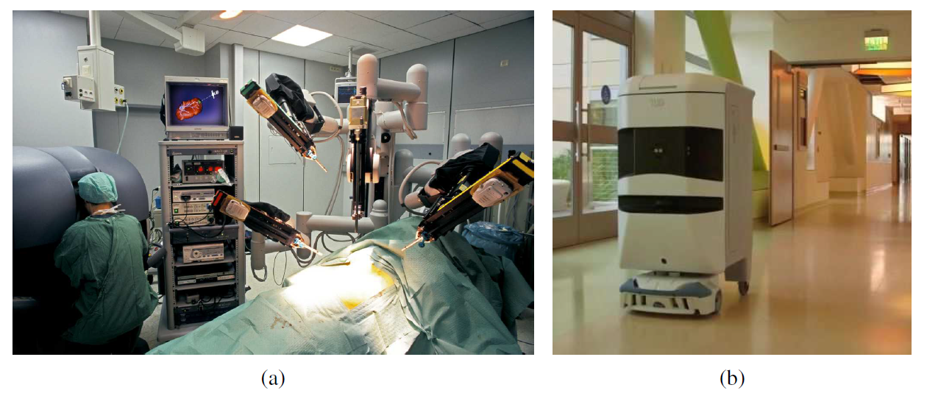
Application Domains
Surgical robot in the operating room
Hospital delivery robot.

Slide 43
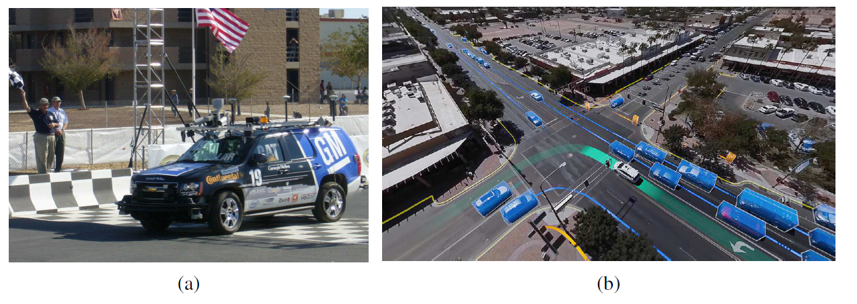
Application Domains
Autonomous car BOSS which won the DARPA Urban Challenge.
Aerial view showing the perception and predictions of the Waymo autonomous car (white vehicle with green track). Other vehicles (blue boxes) and pedestrians (orange boxes) are shown with anticipated trajectories. Road/sidewalk boundaries are in yellow.

Slide 44
Application Domains
Autonomous car BOSS which won the DARPA Urban Challenge.
Aerial view showing the perception and predictions of the Waymo autonomous car (white vehicle with green track). Other vehicles (blue boxes) and pedestrians (orange boxes) are shown with anticipated trajectories. Road/sidewalk boundaries are in yellow.

Slide 45
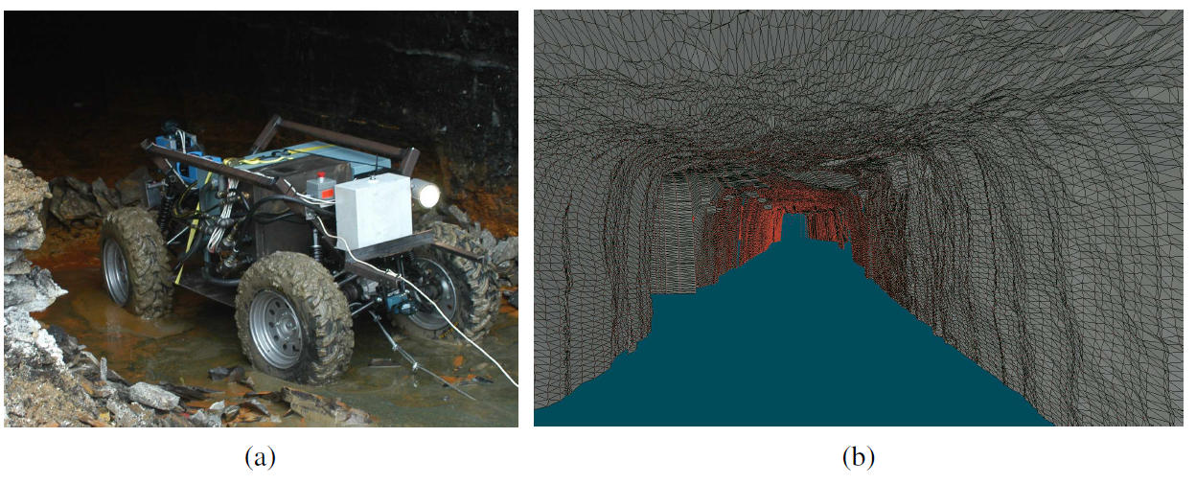
Application Domains
A robot mapping an abandoned coal mine.
A 3D map of the mine acquired by the robot.

Slide 46
Summary
The most common types of robots are manipulators (robot arms) and mobile robots.
They have sensors for perceiving the world and actuators that produce motion, which then affects the world via effectors
The general robotics problem involves stochasticity (which can be handled by MDPs), partial observability (which can be handled by POMDPs), and acting with and around other agents (which can be handled with game theory
Robotic perception concerns itself with estimating decision-relevant quantities from sensor data
Probabilistic filtering algorithms such as particle filters and Kalman filters are useful for robot perception
A path found by a search algorithm can be executed using the path as the reference trajectory for a PID controller,
Planning under uncertainty unites perception and action by online replanning (such as model predictive control) and information gathering actions that aid perception

